Slide 1
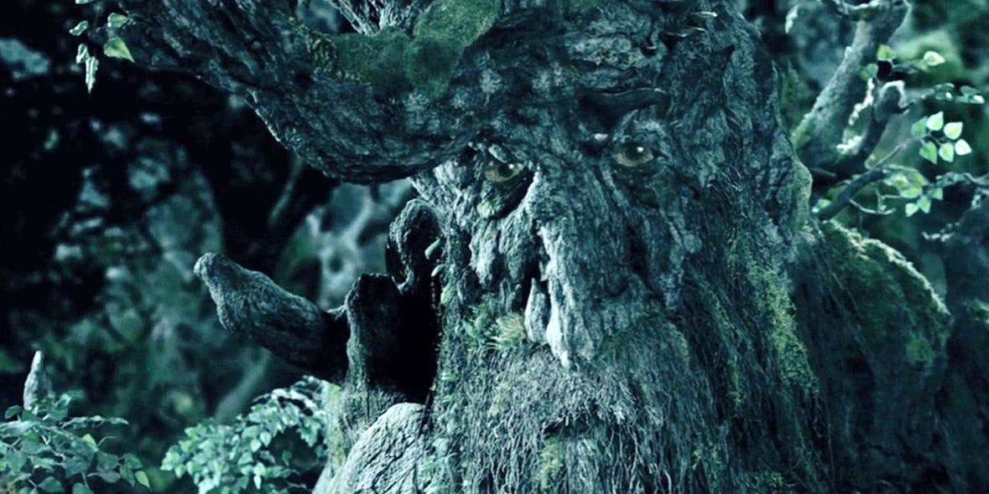
SOEE1475 Statistics and Data Analysis
Lecture 6: Temporal statistics
Graeme T. Lloyd

Slide 2

Today
Temporal patterns
Kolmogorov-Smirnov test
Markov chains

Slide 3
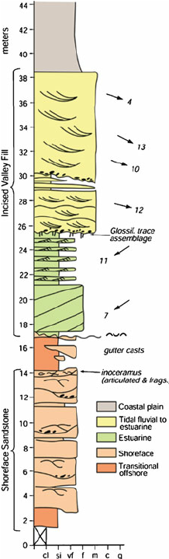
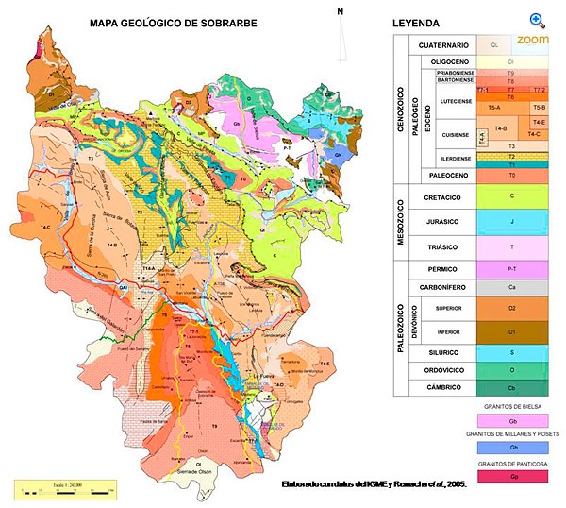
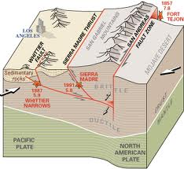
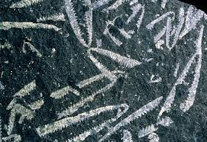
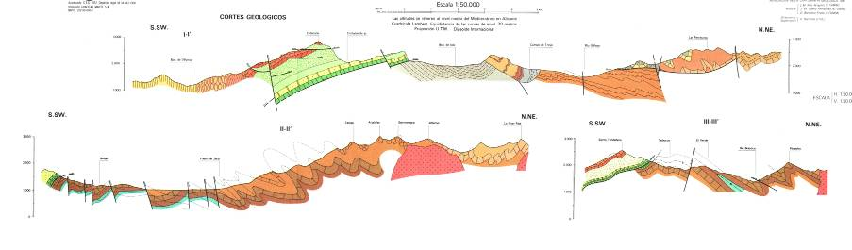
Spatial data in geology
1D
2D
3D

Slide 4
Spatial data in geology
1D
2D
3D

Slide 5
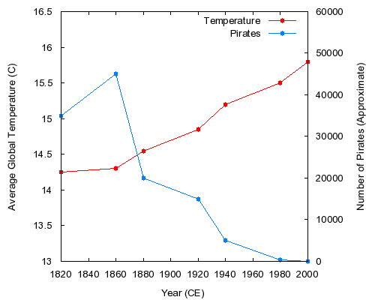


Temporal autocorrelation
cor.test(x = pirates,
y = temp)$estimate
-0.9242241
cor.test(x = pirates,
y = temp)$p.value
0.00291353

Slide 6
Series of events

Slide 7
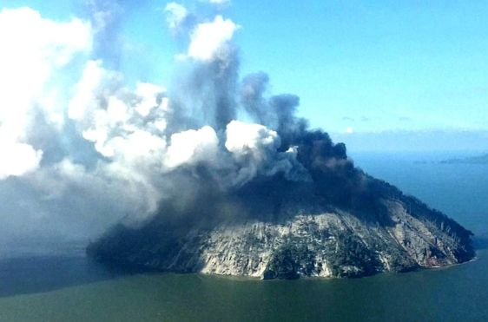
Series of events

Slide 8
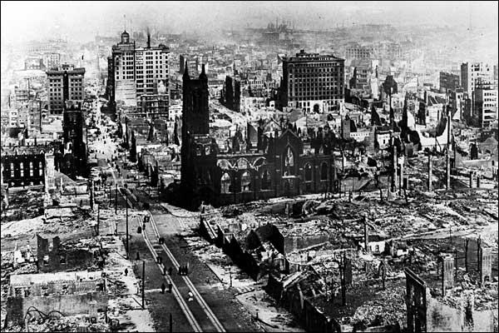
Series of events

Slide 9
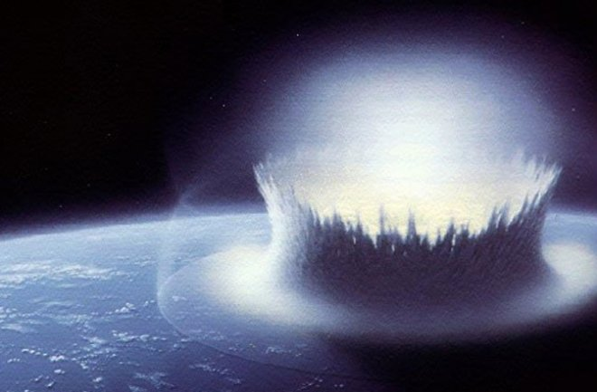
Series of events

Slide 10
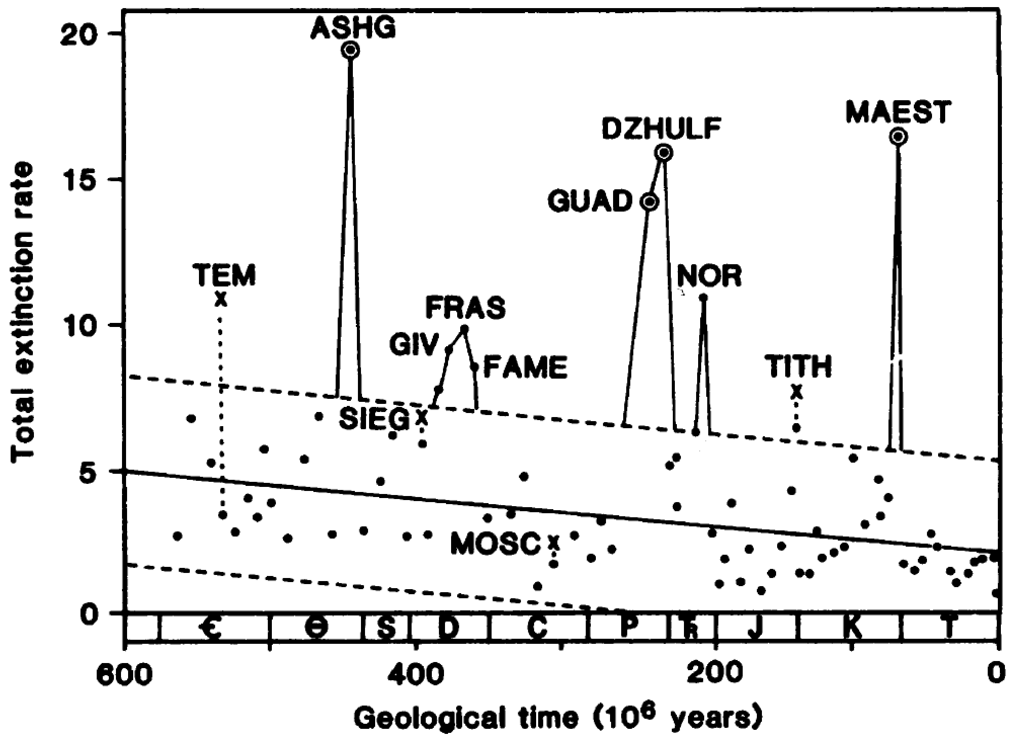
Series of events

Slide 11
Series of events
Regular/uniform

Slide 12
Series of events
Regular/uniform
Random

Slide 13
Series of events
Regular/uniform
Random
Clustered

Slide 14
Series of events
Regular/uniform
Random
Clustered
Trend

Slide 15
Series of events
Regular/uniform
Random
Clustered
Trend
Pattern

Slide 16
Testing for regular/uniform
Regular/uniform

Slide 17
Testing for regular/uniform
Regular/uniform
Cumulative events
Time

Slide 18
Testing for regular/uniform
Regular/uniform
Cumulative events
Time

Slide 19
Testing for regular/uniform
Regular/uniform
Cumulative events
Time

Slide 20
Testing for regular/uniform
Continuous uniform
Probability density function
Continuous uniform
Cumulative distribution function
a
b
a
b
f(x)
0
1

Slide 21
Kolmogorov-Smirnov test
Regular/uniform
Cumulative events
Time

Slide 22
Kolmogorov-Smirnov test
Regular/uniform
Cumulative events
Time

Slide 23
Kolmogorov-Smirnov test
Regular/uniform
Cumulative events
Time

Slide 24
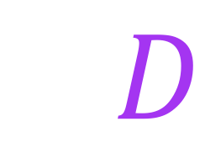
Kolmogorov-Smirnov test
Regular/uniform
Cumulative events
$$D$$
Time

Slide 25
Kolmogorov-Smirnov test
$$0≤D≤1$$

Slide 26
Kolmogorov-Smirnov test
$$0≤D≤1$$

Slide 27
Kolmogorov-Smirnov test
$$0≤D≤1$$

Slide 28
Kolmogorov-Smirnov test
$$0≤D≤1$$

Slide 29
Kolmogorov-Smirnov test
x <- runif(20)
ks.test(x = x, y = "punif")$statistic
ks.test(x = x, y = "punif")$p.value

Slide 30
Kolmogorov-Smirnov test
Assesses “goodness of fit” between two distributions
Like Chi-squared, but for continuous rather than categorical data

Slide 31
Kolmogorov-Smirnov test
Assesses “goodness of fit” between two distributions
Like Chi-squared, but for continuous rather than categorical data
Allows us to choose expected value (null model)
Also like Chi-squared; flexible

Slide 32
Kolmogorov-Smirnov test
Assesses “goodness of fit” between two distributions
Like Chi-squared, but for continuous rather than categorical data
Allows us to choose expected value (null model)
Also like Chi-squared; flexible
One way to test if data approximate a specific distribution type
E.g., are data uniform? Are data normal?

Slide 33
Kolmogorov-Smirnov test
One-sample
ks.test(x = runif(20), y = "punif")
ks.test(x = runif(20), y = "pnorm")

Slide 34
Kolmogorov-Smirnov test
One-sample
ks.test(x = runif(20), y = "punif")
ks.test(x = runif(20), y = "pnorm")
Two sample
ks.test(x = runif(20), y = runif(20))
ks.test(x = runif(20), y = rnorm(20))

Slide 35
Testing for random
Random

Slide 36
Testing for random
Random

Slide 37
Testing for random
Random
1
1
0
2
1
0
0
1
1
1
1
1

Slide 38
Testing for random
Random
1
1
0
2
1
0
0
1
1
1
1
1
Expected?

Slide 39
Testing for random
Poisson distribution
$$P(X=x)=\frac{λ^{k}e^{−λ}}{k!}$$
Has single parameter ($λ$), the mean

Slide 40
Testing for random
Poisson distribution
$$P(X=x)=\frac{λ^{k}e^{−λ}}{k!}$$
Has single parameter ($λ$), the mean
Expresses probability of given number of events
Assumes randomness; events can occur in space or time

Slide 41
Testing for random
Poisson distribution
$$P(X=x)=\frac{λ^{k}e^{−λ}}{k!}$$
Has single parameter ($λ$), the mean
Expresses probability of given number of events
Assumes randomness; events can occur in space or time
Good null for random distribution of points in space time
I.e., in example expected N time bins with k events

Slide 42
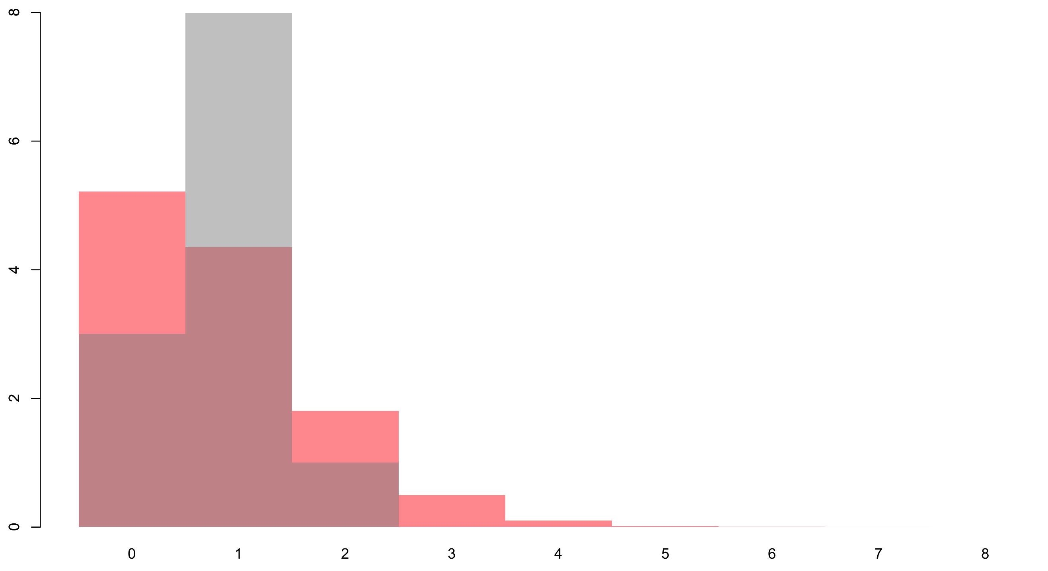
Testing for random

Slide 43
Testing for random
O_{j}
E_{j}

Slide 44
Testing for clustered
Clustered

Slide 45
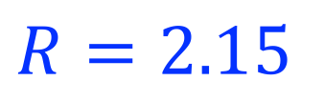
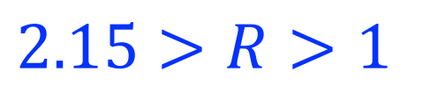
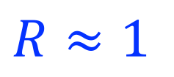
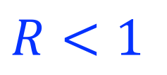
Testing for clustered
Clustered
Regular
Uniform
Random
Clustered
$$R=2.15$$
$$2.15>R>1$$
$$R≈1$$
$$R<1$$

Slide 46
Testing for clustered
Clustered

Slide 47
Testing for clustered
Clustered

Slide 48
Testing for clustered
Clustered

Slide 49
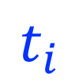
Testing for clustered
Clustered
$$t_{i}$$

Slide 50
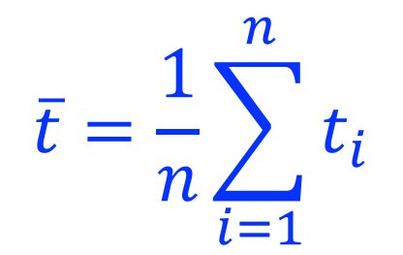
Testing for clustered
Mean nearest neighbour time
$$\overline{t}=\frac{1}{n}\sum_{i=1}^{n}{t_{i}}$$
Captures average time to nearest event

Slide 51
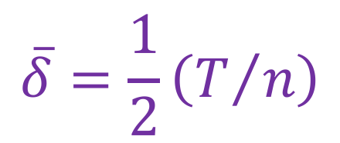
Testing for clustered
Mean nearest neighbour time
$$\overline{t}=\frac{1}{n}\sum_{i=1}^{n}{t_{i}}$$
Captures average time to nearest event
Expected mean nearest neighbour time
$$\overline{δ}=\frac{1}{2}\left(T/n\right)$$
Uses total time (T) and number of events (n)

Slide 52
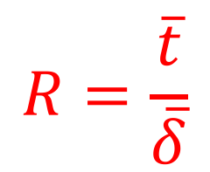
Testing for clustered
Mean nearest neighbour time
$$\overline{t}=\frac{1}{n}\sum_{i=1}^{n}{t_{i}}$$
Captures average time to nearest event
Expected mean nearest neighbour time
$$\overline{δ}=\frac{1}{2}\left(T/n\right)$$
Uses total time (T) and number of events (n)
Nearest neighbour statistic
$$R=\frac{\overline{t}}{\overline{δ}}$$
Varies from 0 to c. 2

Slide 53
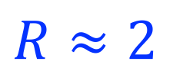
Testing for clustered
Regular
$$R≈2$$

Slide 54
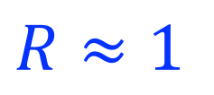
Testing for clustered
Regular
$$R≈2$$
Random
$$R≈1$$

Slide 55
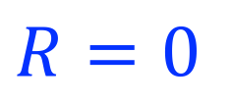
Testing for clustered
Regular
$$R≈2$$
Random
$$R≈1$$
Point
$$R=0$$

Slide 56
Testing for clustered
Regular
$$R≈2$$
Random
$$R≈1$$
Clustered
Point
$$R=0$$

Slide 57
Testing for trend
Trend

Slide 58
Testing for trend
Trend
Notes:
To capture a trend of increasing or decreasing frequency of events can visualise data as time since last event in event order.

Slide 59
Testing for trend
Trend
t_{i} – t_{i-1}
Event order
Notes:
To capture a trend of increasing or decreasing frequency of events can visualise data as time since last event in event order.

Slide 60
Testing for trend
Trend
t_{i} – t_{i-1}
Event order
Notes:
To capture a trend of increasing or decreasing frequency of events can visualise data as time since last event in event order.

Slide 61
Testing for trend
Trend
t_{i} – t_{i-1}
Event order
Notes:
To capture a trend of increasing or decreasing frequency of events can visualise data as time since last event in event order.

Slide 62
Testing for trend
-1
0
1
Notes:
This should remind us of Pearson’s correlation coefficient, but now we are considering a scale that spans from increasing frequency of events (-1) to decreasing frequency of events (1) via no trend in frequency between events at 0

Slide 63
Testing for trend
-1
0
1
Increasing event
frequency
Decreasing event
frequency
Notes:
This should remind us of Pearson’s correlation coefficient, but now we are considering a scale that spans from increasing frequency of events (-1) to decreasing frequency of events (1) via no trend in frequency between events at 0

Slide 64
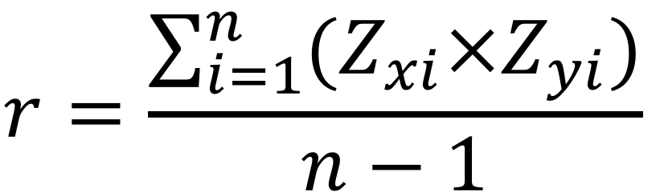
Testing for trend
Pearson correlation coefficient, r
$$r=\frac{\sum_{i=1}^{n}{(Z_{xi}×Z_{yi})}}{n−1}$$

Slide 65
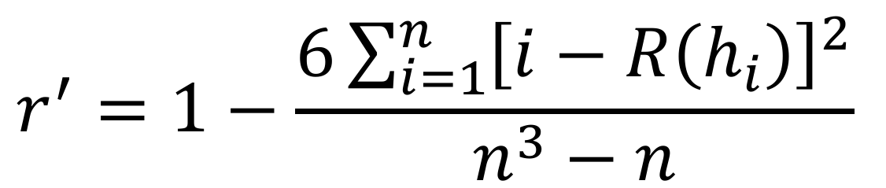
Testing for trend
Pearson correlation coefficient, r
$$r=\frac{\sum_{i=1}^{n}{(Z_{xi}×Z_{yi})}}{n−1}$$
Spearman rank correlation coefficient, r’
$$r^{′}=1−\frac{6\sum_{i=1}^{n}{{\left[i−R\left(h_{i}\right)\right]}^{2}}}{n^{3}−n}$$

Slide 66
Testing for trend
Pearson correlation coefficient, r
PARAMETRIC
$$r=\frac{\sum_{i=1}^{n}{(Z_{xi}×Z_{yi})}}{n−1}$$
Spearman rank correlation coefficient, r’
NON-PARAMETRIC
$$r^{′}=1−\frac{6\sum_{i=1}^{n}{{\left[i−R\left(h_{i}\right)\right]}^{2}}}{n^{3}−n}$$

Slide 67
Testing for trend
Spearman rank correlation coefficient, r’
cor.test(x = x, y = y, type = "spearman")$estimate
cor.test(x = x, y = y, type = "spearman")$p.value

Slide 68
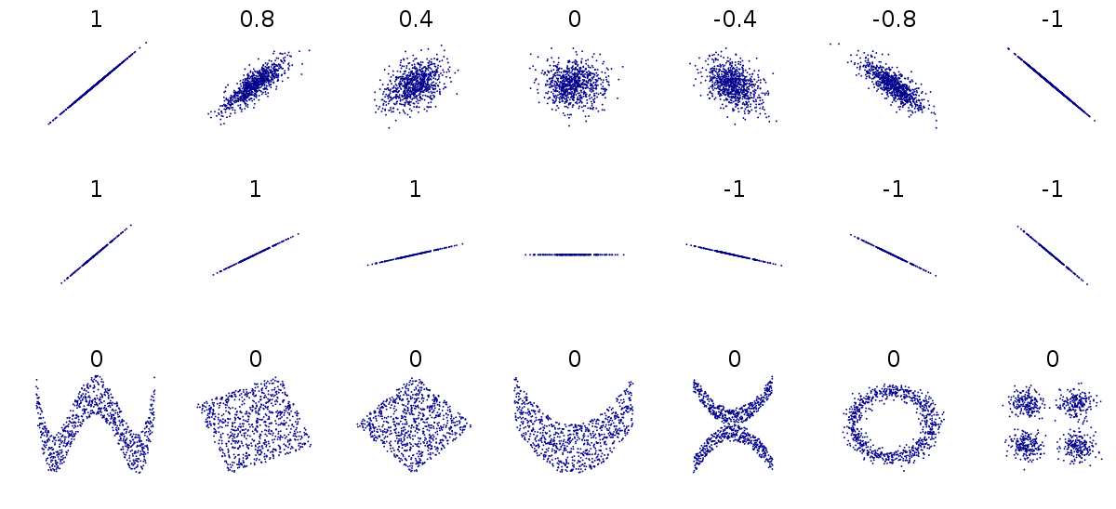
Testing for trend

Slide 69
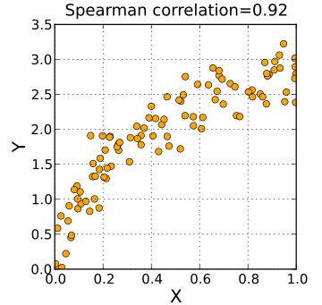
Testing for trend

Slide 70
Testing for pattern
Pattern

Slide 71
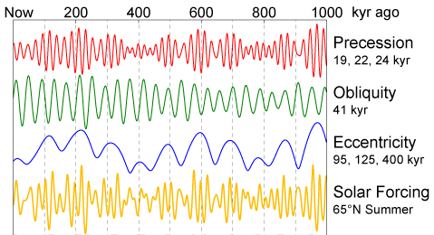
Testing for pattern
Pattern

Slide 72
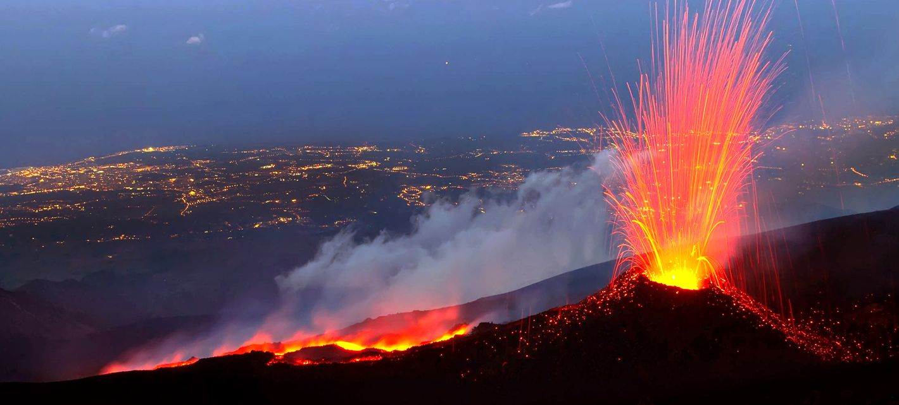
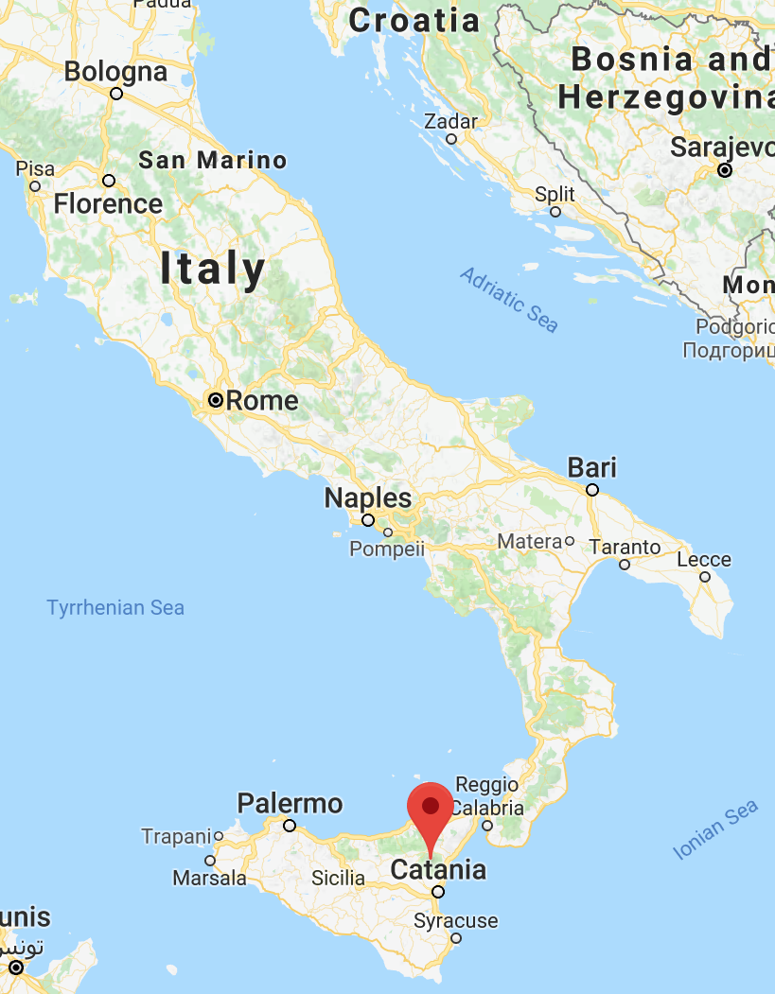
Exercise

Slide 73
Exercise
EtnaEruptionYears <- c(1169, 1169, 1329, 1329, 1536, 1669, 1669,
1693, 1832, 1843, 1868, 1928, 1929, 1979, 1981, 1984, 1985,
1987, 1991)

Slide 74
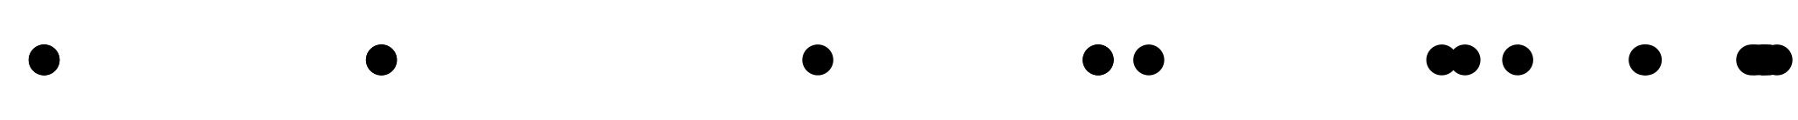
Exercise
EtnaEruptionYears <- c(1169, 1169, 1329, 1329, 1536, 1669, 1669,
1693, 1832, 1843, 1868, 1928, 1929, 1979, 1981, 1984, 1985,
1987, 1991)
1000
2000

Slide 75
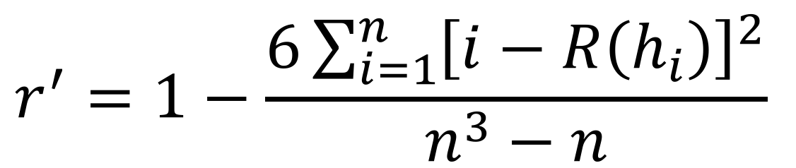
Exercise
$$r^{′}=1−\frac{6\sum_{i=1}^{n}{{\left[i−R\left(h_{i}\right)\right]}^{2}}}{n^{3}−n}$$
Notes:
To test for a trend we want to use Spearman rank correlation. Use whiteboard to show table they need to fill out (rank of x, rank of y, difference, difference^2), then sum that column and multiply by six, n here is not tatl number of eruptions (19) but one less.

Slide 76
Exercise
$$r^{′}=1−\frac{6\sum_{i=1}^{n}{{\left[i−R\left(h_{i}\right)\right]}^{2}}}{n^{3}−n}$$
diff(EtnaEruptionYears)
0 160 0 207 133 0 24 139 11 25 60 1 50 2 3 1 2 4

Slide 77
Exercise
$$r^{′}=1−\frac{6\sum_{i=1}^{n}{{\left[i−R\left(h_{i}\right)\right]}^{2}}}{n^{3}−n}$$
diff(EtnaEruptionYears)
0 160 0 207 133 0 24 139 11 25 60 1 50 2 3 1 2 4
rank(diff(EtnaEruptionYears))
2 17 2 18 15 2 11 16 10 12 14 4.5 13 6.5 8 4.5 6.5 9

Slide 78
Exercise
$$r^{′}=1−\frac{6\sum_{i=1}^{n}{{\left[i−R\left(h_{i}\right)\right]}^{2}}}{n^{3}−n}$$
diff(EtnaEruptionYears)
0 160 0 207 133 0 24 139 11 25 60 1 50 2 3 1 2 4
rank(diff(EtnaEruptionYears))
2 17 2 18 15 2 11 16 10 12 14 4.5 13 6.5 8 4.5 6.5 9
1:18 # temporal rank order of eruptions
1 2 3 4 5 6 7 8 9 10 11 12 13 14 15 16 17 18

Slide 79
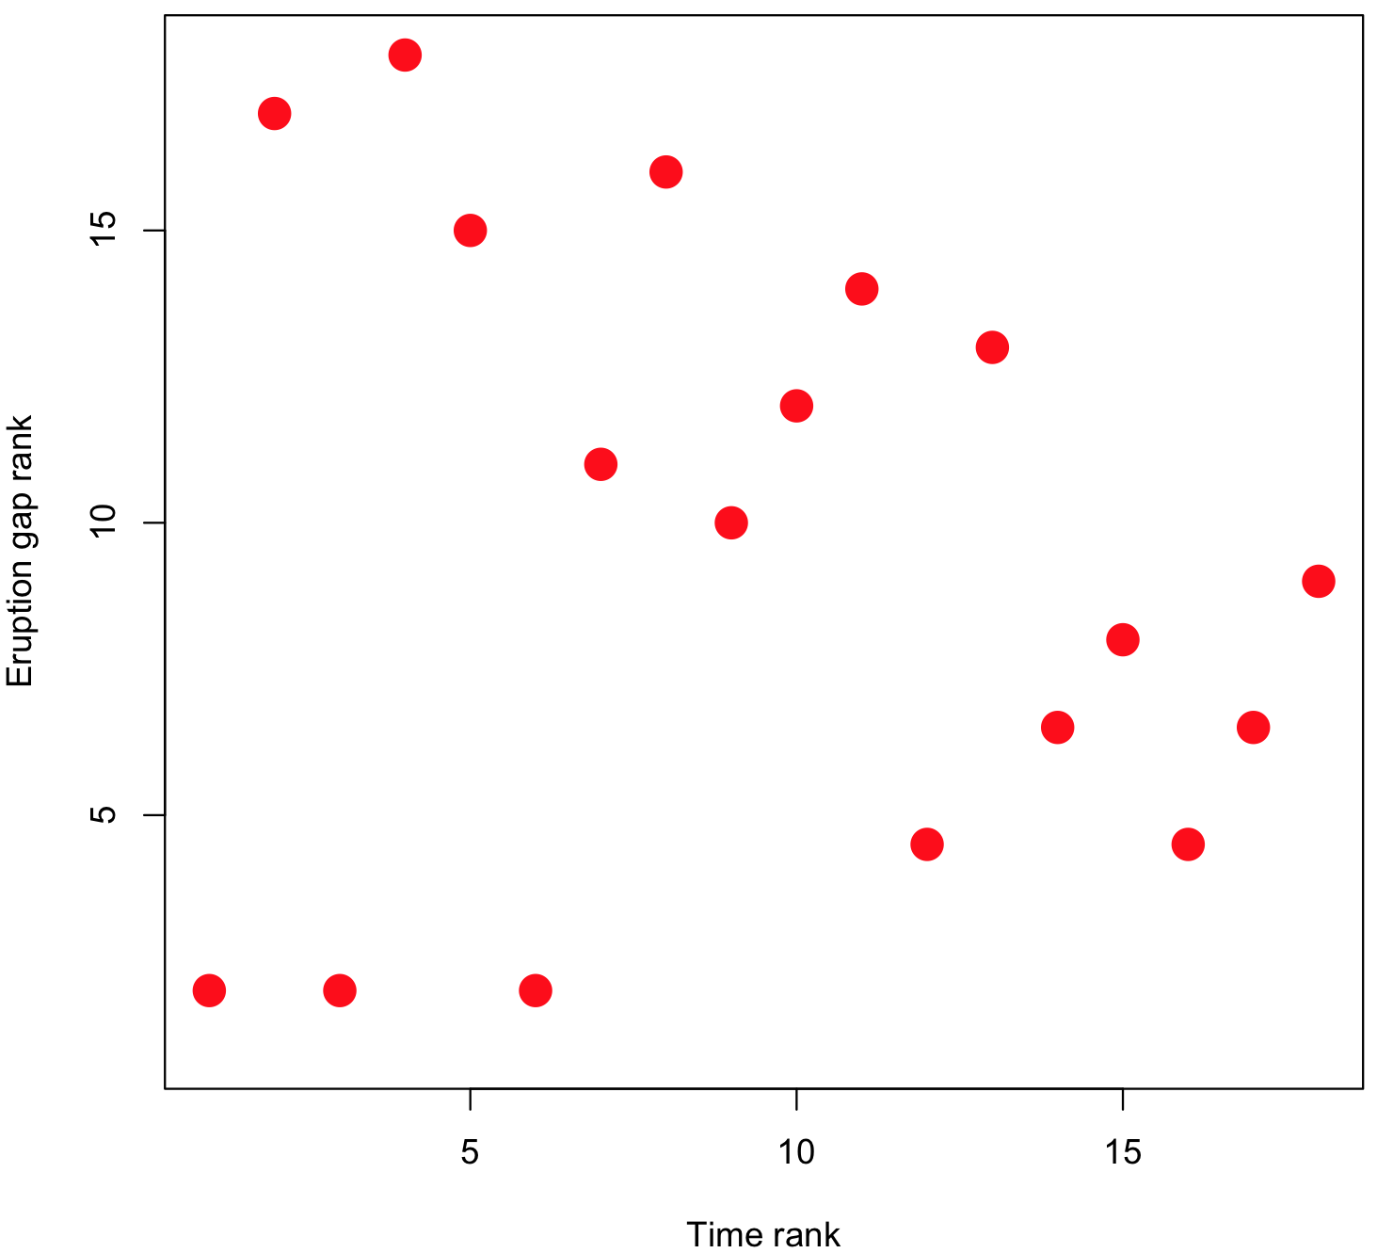
Exercise

Slide 80
Markov chains
A
B

Slide 81
Markov chains
A
B

Slide 82
Markov chains
A
B
A
B
A
B
A
B
A
B
A
B
A
B
A
B
A
B
A
B
A
B

Slide 83
Markov chains
p(A -> B) = 1
A
B
p(B -> A) = 1
A
B
A
B
A
B
A
B
A
B
A
B
A
B
A
B
A
B
A
B
Notes:
Can express this pattern as probability of state transition at next time step. Note that probabilities only need to sum to one across starting states.

Slide 84
Markov chains
A
B

Slide 85
Markov chains
p(A -> B) = 0.5
p(A -> A) = 0.5
A
B
p(B -> B) = 0.5
p(B -> A) = 0.5
Notes:
Can, for example, imagine probability of changing state is equal to fair coing

Slide 86
Markov chains
p(A -> B) = 0.5
p(A -> A) = 0.5
A
B
p(B -> B) = 0.5
p(B -> A) = 0.5
A
A
B
A
B
B
A
A
A
B
A
B
B
A
B
A
A
B
B
A

Slide 87
Markov chains
p(A -> B) = ?
p(A -> A) = ?
A
B
p(B -> B) = ?
p(B -> A) = ?
A
A
B
A
B
B
A
A
A
B
A
B
B
A
B
A
A
B
B
A

Slide 88
Markov chains

Slide 89
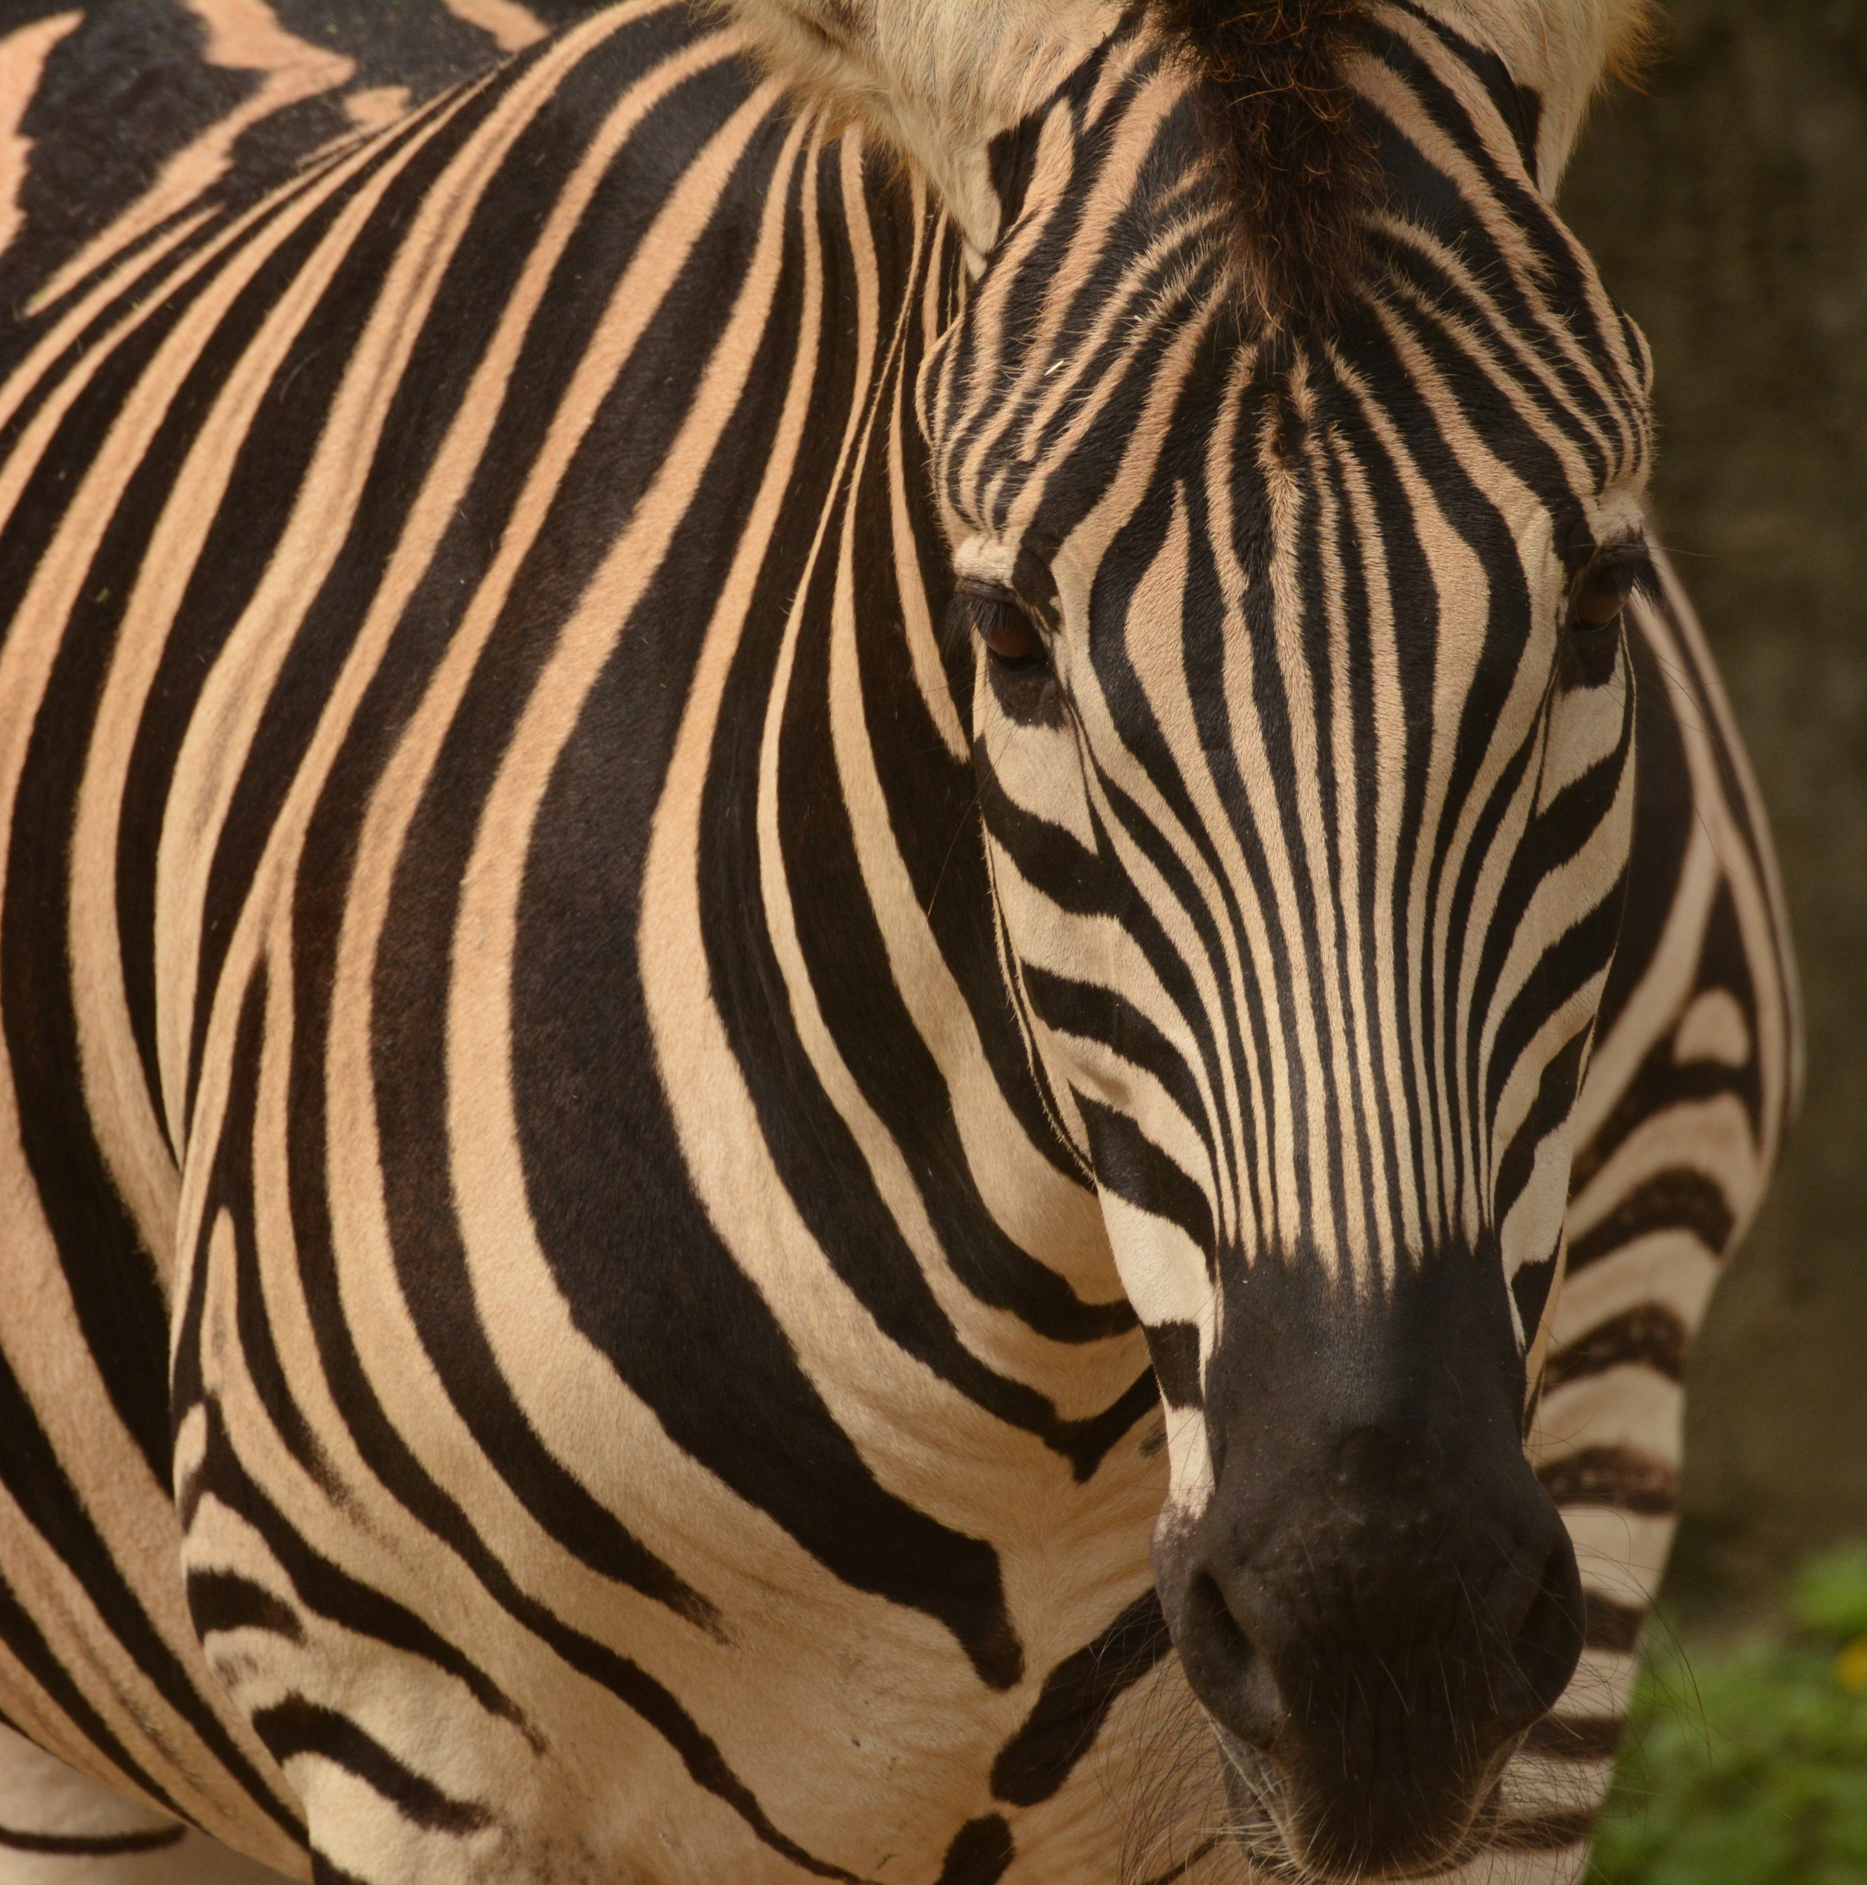
Markov chains

Slide 90
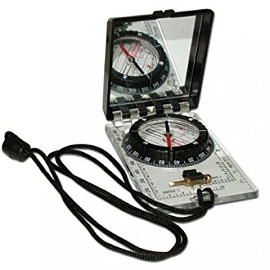
Markov chains

Slide 91
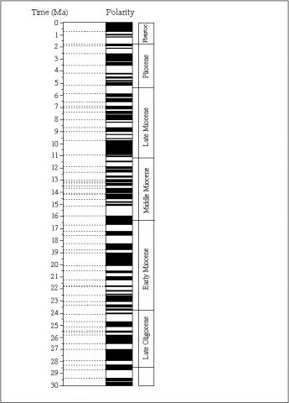
Markov chains
Normal
Reversed

Slide 92
Markov chains
Normal
Reversed

Slide 93
Markov chains
Normal
Reversed
N
R

Slide 94
Markov chains
Normal
Reversed
N
R

Slide 95
Markov chains
Normal
p(N -> R) = ?
Reversed
p(N -> N) = ?
N
R
p(R -> R) = ?
p(R -> N) = ?

Slide 96
Markov chains

Slide 97
Markov chains

Slide 98
Markov chains
3
5
5
5

Slide 99
Markov chains
3
p(N -> N) = 3 / (3 + 5)
5
p(N -> R) = 5 / (3 + 5)
5
p(R -> R) = 5 / (5 + 5)
5
p(R -> N) = 5 / (5 + 5)

Slide 100
Markov chains
3
p(N -> N) = 3 / (3 + 5) = 0.375
5
p(N -> R) = 5 / (3 + 5) = 0.625
5
p(R -> R) = 5 / (5 + 5) = 0.500
5
p(R -> N) = 5 / (5 + 5) = 0.500

Slide 101
Markov chains
Transition frequency matrix
To
3
5
From
5
5

Slide 102
Markov chains
Transition frequency matrix
Transition probability matrix
To
To
3
5
0.375
0.625
From
From
5
5
0.500
0.500

Slide 103
Markov chains
A
B
C

Slide 104
Markov chains
A
B
C
D

Slide 105
Markov chains
A
B
A
A
B
B
C
C
D

Slide 106
Markov chains
Sedimentary sequence

Slide 107
Markov chains
Sedimentary sequence
No clear pattern

Slide 108
Markov chains
Sedimentary sequence
No clear pattern
Rhythmic sedimentation

Slide 109
Markov chains
No clear pattern
Rhythmic sedimentation

Slide 110
Markov chains
Sandstone
Shale
No clear pattern
Rhythmic sedimentation
Coal
Limestone

Slide 111
Markov chains
Transition freq. matrix
2
1
1
2
No clear pattern
2
2
1
1
1
2
1
1
1
1
2
2

Slide 112
Markov chains
Transition freq. matrix
Transition freq. matrix
2
1
1
2
0
6
0
0
No clear pattern
2
2
Rhythmic sedimentation
0
0
6
0
1
1
1
2
1
1
0
0
0
6
1
1
2
2
6
0
0
0

Slide 113
Markov chains
Transition prob. matrix
Transition prob. matrix
0.3
0.2
0.2
0.3
0
1
0
0
No clear pattern
0.3
0.3
Rhythmic sedimentation
0
0
1
0
0.2
0.2
0.2
0.3
0.2
0.2
0
0
0
1
0.2
0.2
0.3
0.3
1
0
0
0

Slide 114
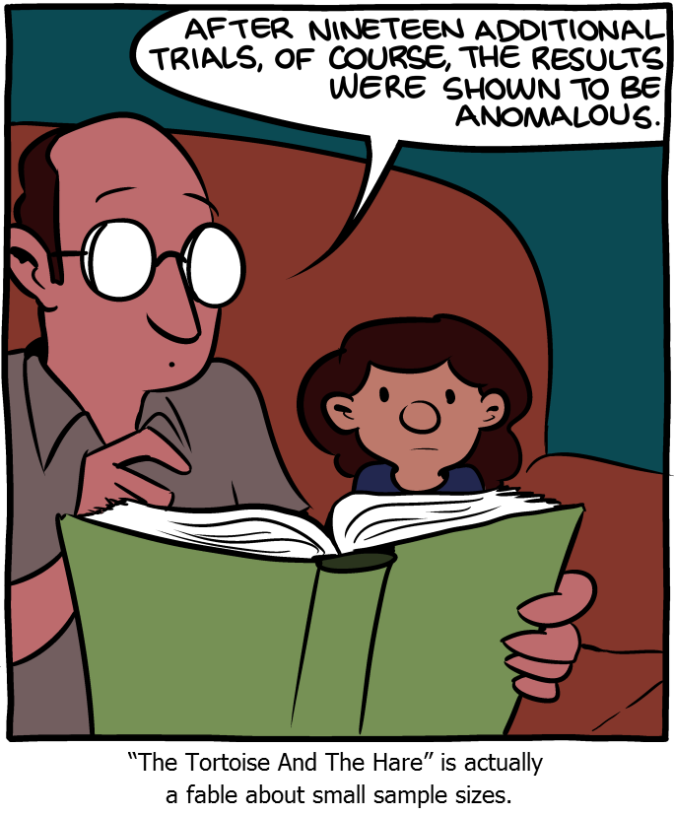
The importance of multiple replicates
Source: SMBC

